Slide 1
Comparison of
Ucie 2.0 & Ucie 3.0
K.LOKESH
Chipweave Technologies Private Limited

Slide 2
UCIe 2.0 introduces two major innovations
Manageability & DFx (Test, Debug, Telemetry)
UCIe-3D (Vertical chiplet integration)
First, it solves problems related to testing, debugging, and managing multiple chiplets inside a System-in-Package (SiP).
Since chiplets are placed inside a package, it is difficult to access them directly. UCIe 2.0 provides a system-level solution to manage, test, and debug chiplets, while still being backward compatible with earlier UCIe versions.
Second, UCIe 2.0 supports 3D chiplet integration, called UCIe-3D.
This allows chiplets to be stacked vertically using hybrid bonding with very small bump sizes, from 9 µm down to about 1 µm.
This improves performance, power efficiency, and bandwidth density.

Slide 3
UCIe 2.0 focuses on improving testing, debugging, and manageability of chiplet-based System-in-Package designs across the entire silicon life cycle.
While UCIe 1.0 and 1.1 already provided some DFx features at the interconnect level, many challenges still remain at the chiplet and package level.
These include difficulty in testing micro-bumps,
limited access to internal chiplets for debugging,
The need for secure manageability,
Firmware updates in the field, and different bandwidth requirements for scan, debug, and management functions.
UCIe 2.0 addresses these issues in a holistic, system-level manner, enabling a reliable, secure, and plug-and-play chiplet ecosystem.

Slide 4
UCIe 2.0 defines a common and flexible infrastructure to manage, test, and debug chiplets using existing IPs and external interfaces such as PCIe or SMBus. It allows access to internal chiplets through package pins using bridging mechanisms and works seamlessly with on-package UCIe links.
Manageability in UCIe 2.0 is optional and supports functions like chiplet discovery, configuration, firmware download, power and thermal monitoring, error reporting, telemetry, logging, security, and test/debug operations.

Slide 5
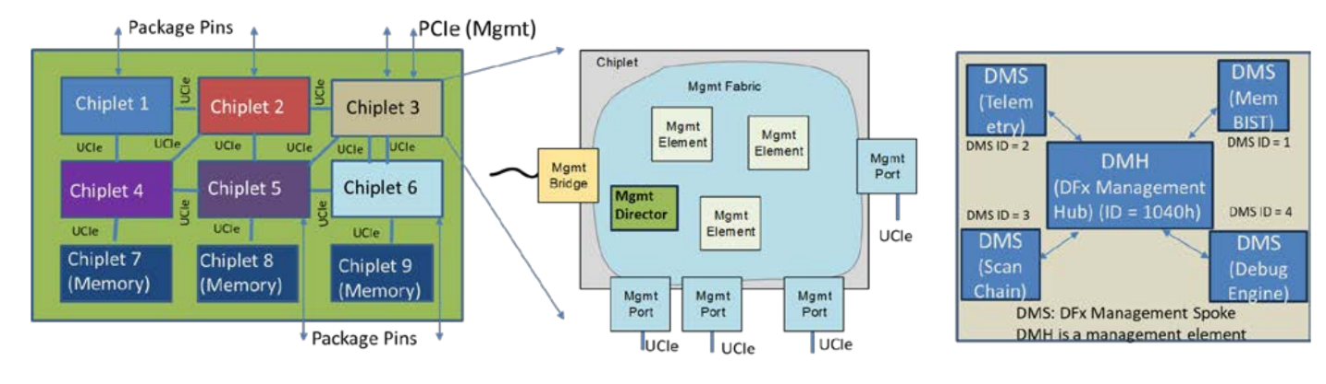
A management fabric is used where one chiplet acts as a management director to control and coordinate all chiplets securely. DFx operations follow a hub-and-spoke model, where a central hub routes test, debug, and telemetry requests to specific functional blocks. Dedicated UCIe-S ports can also be used to provide additional bandwidth for manageability and debug needs.

Slide 6
UCIe-3D enables vertically integrated chiplets to achieve major improvements in performance and power efficiency.
While UCIe 1.0 focused on planar connectivity (2D and 2.5D), UCIe 2.0 extends this to support both planar and 3D chiplet integration. Advances in 3D packaging technologies, such as hybrid bonding, have made it possible to stack chiplets with extremely small bump pitches ranging from 9 µm down to about 1 µm.
This greatly reduces the distance between chiplets, leading to very high bandwidth density and low power consumption.
Although 3D chiplets must use matching bump pitches and are not fully plug-and-play, the performance and power benefits are significant, making UCIe-3D a key technology for next-generation systems.

Slide 7
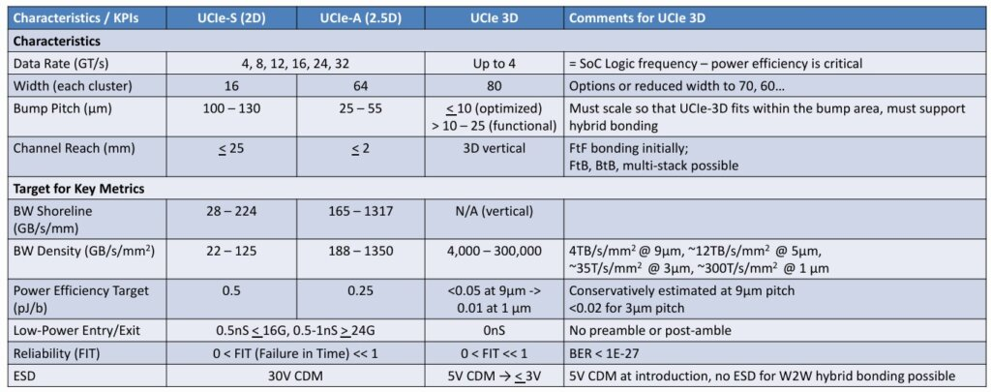

Slide 8
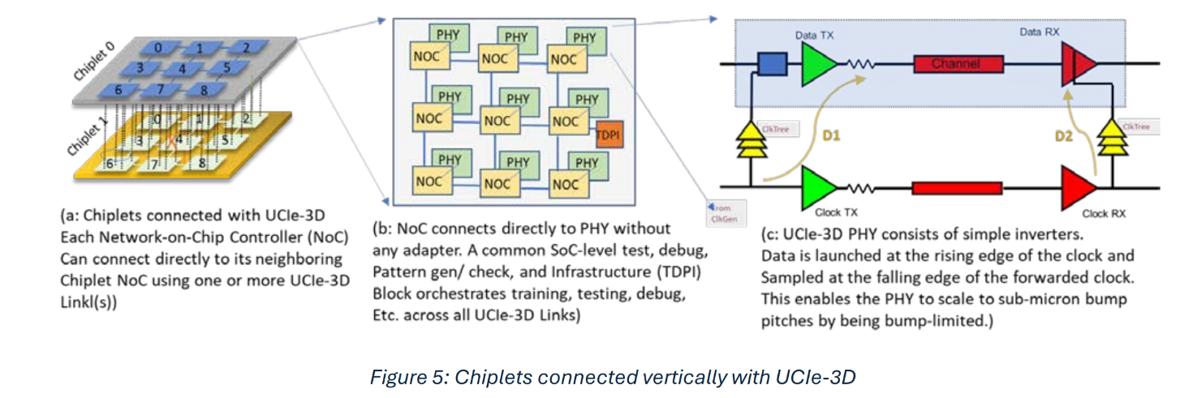
UCIe-3D provides much higher bandwidth density
Uses very small bump pitch (from ~9 µm down to <1 µm)
Smaller bump pitch → many more wires in the same area
Example: 5 µm (3D) gives ~25× more wires than 25 µm (2.5D)
Uses vertical connections instead of edge (shoreline) connections
No PHY at chip edges, so no area is wasted
Entire chiplet area is used for connectivity

Slide 9
Ucie 3.0
UCIe 3.0 is a major step forward in chiplet interconnect technology.
It is designed to meet the high bandwidth needs of AI, HPC, and data-intensive applications.
UCIe 3.0 introduces higher data rates, support for continuous data transfer, better power efficiency, and stronger manageability, while still remaining backward compatible with earlier UCIe versions.
These improvements make UCIe a key technology for building efficient, scalable, and reliable System-in-Package (SiP) designs.

Slide 10
Doubling Data Rates for UCIe-A (Advanced Package, 2.5D) and UCIe-S (Standard Package, 2D)
Modern applications like AI, HPC, and data analytics need very high bandwidth.
Chiplets have limited edge (shoreline) area, so bandwidth must be increased efficiently.
UCIe 3.0 doubles the data rate:
From 32 GT/s → 64 GT/s
Also supports 48 GT/s
This improves shoreline bandwidth density without increasing interface size.
Backward Compatibility
UCIe 3.0 is fully backward compatible.
Existing sideband, data, training, and signaling protocols are preserved
Older UCIe chiplets can work seamlessly with UCIe 3.0 systems

Slide 11
Technical Approach for Higher Data Rates in UCIe 3.0
UCIe 3.0 achieves higher data rates using Non-Return-to-Zero (NRZ) unidirectional signaling, which provides reliable and efficient data transmission and is consistent with earlier UCIe versions.
To support 48 GT/s and 64 GT/s, the specification uses quarter-rate clocking, ensuring stable operation at high speeds.
Reliability is maintained by achieving low Bit Error Rate (BER) and by continuing to use existing Cyclic Redundancy Check (CRC) and replay mechanisms.
Signal quality is further improved using enhanced equalization techniques such as Transmit Feed-Forward Equalizer (TX-FFE) for signal shaping and Receive Continuous-Time Linear Equalizer (RX-CTLE) to compensate for channel losses.
An optional Receive Decision Feedback Equalizer (RX-DFE) can be used when additional signal correction is required.
Additionally, enhancements to the Link Training State Machine (LTSM) perform I/O corrections and select optimal equalization presets to ensure sufficient eye margin at higher data rates.

Slide 12
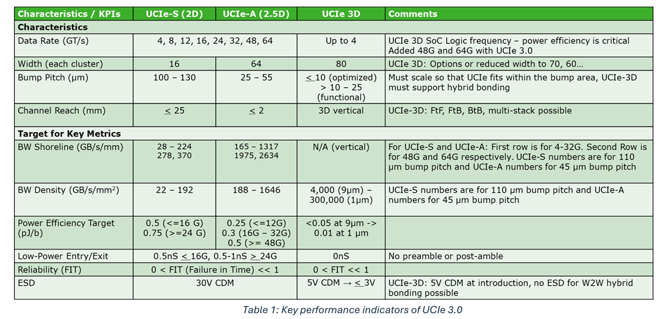

Slide 13
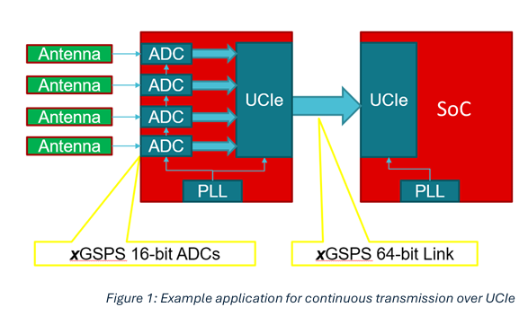
Support for Continuous Transmission Protocols (New Usage for UCIe)
UCIe 3.0 supports continuous data transfer, which is needed for applications like Digital Signal Processing (DSP).
In such systems, data must flow continuously between an ADC chiplet and a SoC without breaks.
UCIe 3.0 runs the link at the same speed as data generation, so data moves smoothly and with low delay. This removes the need for extra PLLs, reducing noise in analog circuits.
The data rate can be adjusted using the reference clock, and existing UCIe mechanisms are reused to keep the design simple and reliable.

Slide 14
Operational Power Savings Enhancement
Power efficiency is very important in modern systems, especially as designs become more complex.
UCIe 3.0 improves power efficiency by allowing the transmitter (TX) to adjust the clock-to-data timing while the link is running.
Earlier, this adjustment was only possible on the receiver (RX) side during operation.
By reusing the TX adjustment capability during normal operation, UCIe 3.0 reduces unnecessary power usage and achieves significant power savings.

Slide 15
Idle Power Savings Optimization during L2
In addition to saving power during operation, UCIe 3.0 also reduces power when the system is idle.
This is done using L2 state, which is the deepest power-saving mode. In L2, power and clocks to the sideband logic are turned off, resulting in much lower power consumption.
To exit L2 safely, UCIe 3.0 uses the existing sideband clock and data pins with simple DC signals. Only a small amount of logic remains active to detect this signal and wake up the system.
This allows the system to save maximum power during idle while still ensuring a reliable and flexible wake-up back to normal operation.

Slide 16
Manageability Enhancements for Seamless Interoperability
As the number of chiplets in a system increases, easy management and smooth communication between chiplets become very important.
UCIe 3.0 improves manageability and interoperability by adding new features that simplify system control and coordination.
These enhancements help build an open and scalable chiplet ecosystem.
The key new features in UCIe 3.0 include firmware download, priority sideband packets, extended sideband reach, open-drain pins at the SiP level, and fast throttle and emergency shutdown, which together enable reliable, secure, and efficient system operation.

Slide 17
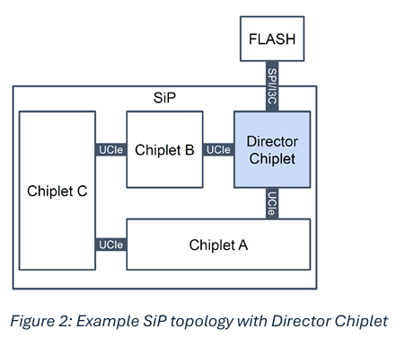
Firmware Download in UCIe 3.0
Modern chiplets need firmware to work correctly, but giving each chiplet its own flash memory increases cost and complexity.
UCIe 3.0 solves this by providing a simple firmware download mechanism using registers, which works through either the sideband or mainband.
A Director Chiplet manages this process by loading firmware from an external source and distributing it to all chiplets in the System-in-Package (SiP). Each chiplet then boots using the downloaded firmware.
After startup, chiplets can request further firmware updates using standard protocols like MCTP (Management Component Transport Protocol) and PLDM (Platform Level Data Model).
This approach simplifies design, reduces cost, and ensures smooth coordination between chiplets.

Slide 18
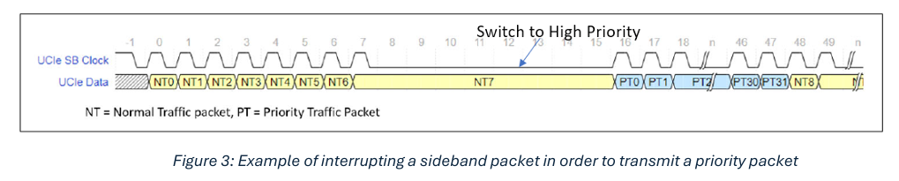
Priority Sideband Packets in UCIe 3.0 (Simple)
Certain events such as power down, wake-up, and low-latency telemetry are critical and must be delivered immediately, unlike large debug dumps which can tolerate delay.
To support this, UCIe 3.0 introduces priority sideband packets that can interrupt normal sideband traffic. The interruption occurs at the next aligned 8UI boundary, followed by the sideband clock going low for 8UI to indicate a priority switch.
The priority packet is then transmitted with a bounded hop-to-hop latency of 48UI (≈60 ns at 800 MHz). Each priority packet is 32UI long and includes a 23-bit priority vector, 5-bit opcode, 3 reserved bits, and 1 parity bit, ensuring fast and reliable delivery of critical system events.

Slide 19
Extended Reach Sideband (UCIe-S Only)
UCIe 3.0 extends the sideband channel reach up to 100 mm, which reduces the need for multiple hops and daisy chaining in System-in-Package (SiP) designs.
This makes it possible to use a star topology, where the director chiplet communicates directly with other chiplets. As a result, the system achieves higher bandwidth, lower latency, and better security.
This feature is especially useful in large and complex SiPs with many chiplets spread over longer distances.
To ensure reliable communication, UCIe 3.0 defines guidelines for input voltage levels (Vih and Vil) and limits the driver on-resistance (Ron) to 60 ohms, maintaining good signal quality over extended distances.

Slide 20
Open Drain Pins
Some critical events like emergency shutdown and fast throttle must be sent to all chiplets at the same time.
UCIe 3.0 introduces open-drain pins to support this.
These pins allow fast, low-latency, two-way signaling and are shared across the entire System-in-Package (SiP).
Because they are routed at the package level, open-drain pins provide a simple, reliable, and efficient way to broadcast urgent signals to all chiplets.

Slide 21
Fast Throttle and Emergency Shutdown
In a System-in-Package (SiP) with many chiplets from different vendors, temperature control is difficult because each chiplet has its own safe temperature limit. If these limits are exceeded, the chiplet can fail.
To handle this safely, UCIe 3.0 introduces two protection mechanisms: Fast Throttle and Emergency Shutdown.
Fast Throttle is used when temperature starts rising. A shared open-drain pin allows any chiplet to signal overheating. When this happens, all chiplets immediately reduce their performance, which lowers power and heat.
Emergency Shutdown is used in extreme cases. If a chiplet crosses its maximum safe temperature, it asserts another open-drain pin that cuts off power to the chiplets and external supplies. This prevents permanent damage to the system.
Together, these mechanisms provide a standard, fast, and reliable way to protect multi-vendor chiplet systems from thermal failures.

Slide 22
Thank You !

Slide 23
Comparison of UCIe 1.0 & 1.1 & 2.0 &3.0
Aspect | UCIe 1.0 | UCIe 1.1 | UCIe 2.0 | UCIe 3.0
Design Focus | Basic chiplet connectivity | Refinement & adoption | Manageability & DFx | Performance, power & scalability
Max Data Rate | Up to 32 GT/s | Up to 32 GT/s | Up to 32 GT/s | Up to 64 GT/s (also 48 GT/s)
Signaling | NRZ | NRZ | NRZ | NRZ + enhanced EQ
Packaging | 2D / 2.5D | 2D / 2.5D | 2D / 2.5D / 3D | 2D / 2.5D / 3D
Topology | Point-to-point | Point-to-point | Limited multi-hop | Star topology
Sideband Reach | Short | Short | Moderate | Extended (100 mm)

Slide 24
Comparison of UCIe 1.0 & 1.1 & 2.0 &3.0
Aspect | UCIe 1.0 | UCIe 1.1 | UCIe 2.0 | UCIe 3.0
Manageability | Not defined | Not defined | System-level | Advanced
DFx (Debug, Test, Telemetry) | Link-level | Improved link-level | System-wide DFx | Enhanced DFx
Firmware Support | Not defined | Not defined | Limited / vendor-specific | Standardized
Continuous Transmission | Not defined | Not defined | Not defined | Supported
Power Optimization | Basic | Basic | Improved | Advanced
Idle Power (L2) | Not defined | Not defined | Not defined | Supported

Slide 25
Comparison of UCIe 1.0 & 1.1 & 2.0 &3.0
Aspect | UCIe 1.0 | UCIe 1.1 | UCIe 2.0 | UCIe 3.0
Thermal Protection | Not defined | Not defined | Not defined | Fast throttle & shutdown
Backward Compatibility | — | With 1.0 | With 1.x | With 1.x & 2.0

